Slide 1
Learning Discrete Representations via Information Maximizing Self-Augmented Training
Weihua Hu, Takeru Miyato, Seiya Tokui, Eiichi Matsumoto, Masashi Sugiyama, ICML, 2017
Zhou Chao

Slide 2
Discrete Representations Learning
Advantages:
The compactness of the representations
Ease of interpretation
Usages:
(i) Clustering
Hash learning
Method:
Deep neural networks, they can model the non-linearity of
data and scale to large datasets.

Slide 3
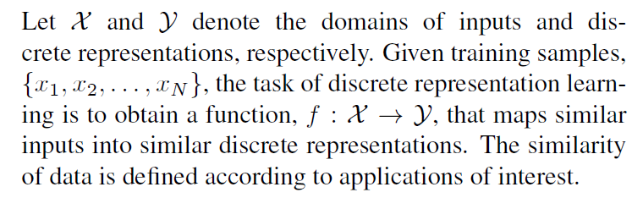
Problem Definition

Slide 4
IMSAT
Information Maximizing
Maximize the information theoretic dependency between data and their predicted discrete representations.
Self-Augmented Training
Use data augmentation to impose the invariance on discrete representations.
Encourage the predicted representations of augmented data points to be close to those of the original data points in an end-to-end fashion.

Slide 5
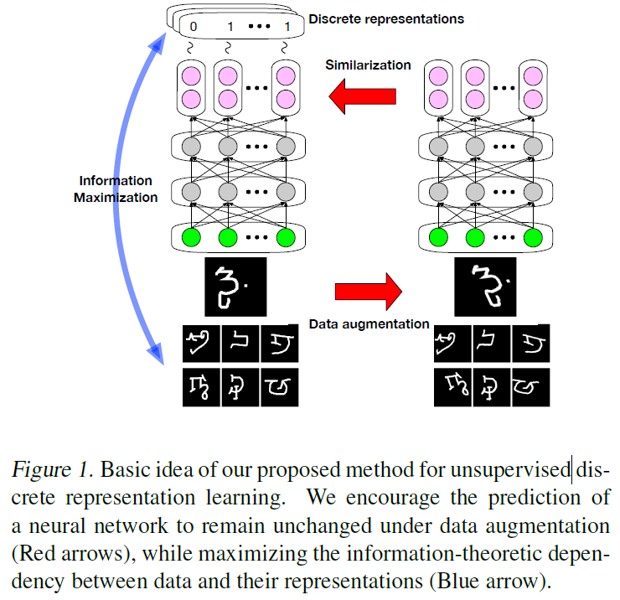
Brief View

Slide 6

RIM
Learns a probabilistic classifier p_{θ}(y|x) such that mutual information between inputs and cluster assignments is maximized.
The RIM minimizes the objective:
Where R(θ) is the regularization penalty, and I(X; Y) is mutual information between X and Y. Hyper-parameter λ trades off the two terms.

Slide 7

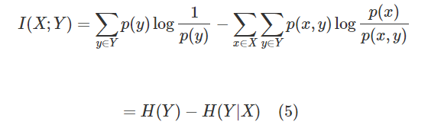
Mutual Information
Mutual information measures the statistical dependency between X and Y , and is 0 if they are independent.

Slide 8
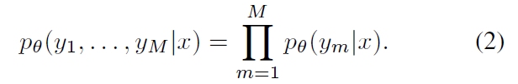
Information Maximization
Extend the RIM and Let the output domain be
Y = Y₁×· · ·×Y_{M} and {y₁, . . . , y_{M}} are conditionally independent given x :
Maximize the mutual information between inputs and their discrete representations, while regularizing the multi-output probabilistic classifier.

Slide 9
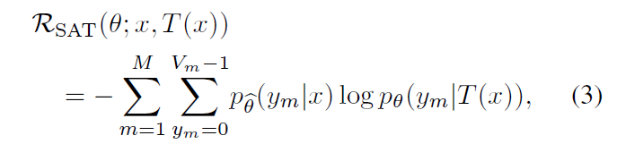
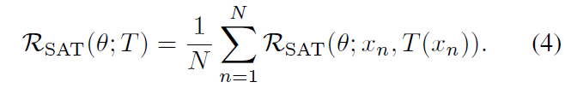
Self-Augmented Training (SAT)
SAT uses data augmentation to impose the intended invariance on the data representations.
The regularization of SAT made on data point x is:
The regularization by SAT is then the average of R_{SAT}(θ; x, T(x)) over all the training data points:

Slide 10

Augmentation Function T
Can be either stochastic or deterministic, can be designed specifically for the applications of interest.
More generally, functions of local perturbations:
Where r is a small perturbation that does not alter the meaning of the data point. The use of local perturbations in SAT encourages the data representations to be locally invariant.

Slide 11

Two Methods
Random Perturbation Training (RPT)
Perturbation r is sampled randomly from hyper-sphere ||r||₂ = ϵ, where ϵ is a hyper-parameter that controls the range of the local perturbation.
Virtual Adversarial Training(VAT)
Perturbation r is chosen to be an adversarial direction:

Slide 12

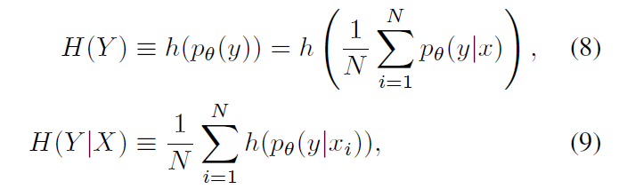
For Clustering
Directly apply the RIM:
Increasing the marginal entropy H(Y ) encourages the cluster sizes to be uniform, while decreasing the conditional entropy H(Y |X) encourages unambiguous cluster assignments.

Slide 13
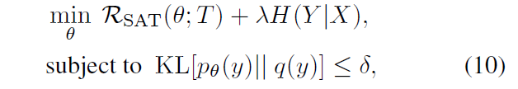
For Clustering
Incorporate our prior knowledge on cluster sizes by modifying H(Y)
Note that H(Y ) = logK − KL[p_{θ}(y)|| U], where K is the number of clusters, KL[·||·] is the Kullback-Leibler divergence, and U is a uniform distribution.
Hence, maximization of H(Y ) is equivalent to minimization of KL[p_{θ}(y)|| U], which encourages predicted cluster distribution p_{θ}(y) to be close to U.
To ensure that p_{θ}(y) is actually close to q(y), we consider the following constrained optimization problem:

Slide 14

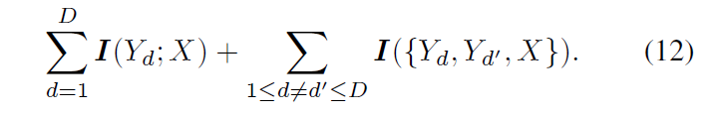
For Hash Learning
The mutual information I(Y₁, . . . ,Y_{D};X) can be expanded as the sum of interaction information:
Where S_{Y} ≡ {Y₁, . . . ,Y_{D}}.
Following Brown (2009), we only retain terms involving pairs of output dimensions in Eq. (11), i.e., all terms where |C| ≤ 2. This gives us:

Slide 15
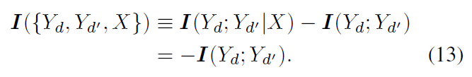
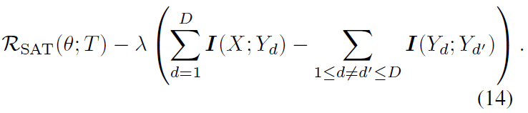
For Hash Learning
It follows from the definition of interaction information and the conditional independence in Eq. (2) that:
In summary, our approximated objective to minimize is:

Slide 16
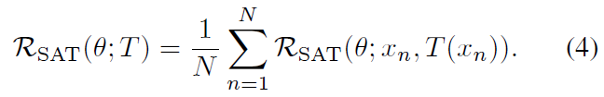
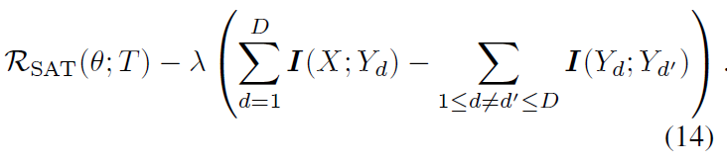
Scale Up To Large Datasets
Aim: Let the objective in Eq. (1) to be amenable to optimization based on mini-batch SGD.
Regularization term:
Approximated objective:

Slide 17

Scale Up To Large Datasets
Decompose the approximated mutual information:
(i) Conditional entropy H(Y_{d}|X)
(ii) Marginal entropy H(Y_{d})
(iii) Mutual information between output dimensions I(Yd; Yd′).
The marginal distribution can only be calculated using the entire dataset and is not amenable to the mini-batch setting.
Approximate the marginal distributions using mini-batch data:

Slide 18
Experiments
Set the network dimensionality to d-1200-1200-M for clustering.
For hash learning, use smaller network sizes to ensure fast computation of mapping data into hash codes.
Use rectified linear units(ReLU) for all the hidden activations.
For the output layer, use the softmax for clustering and the sigmoids for hash learning.

Slide 19
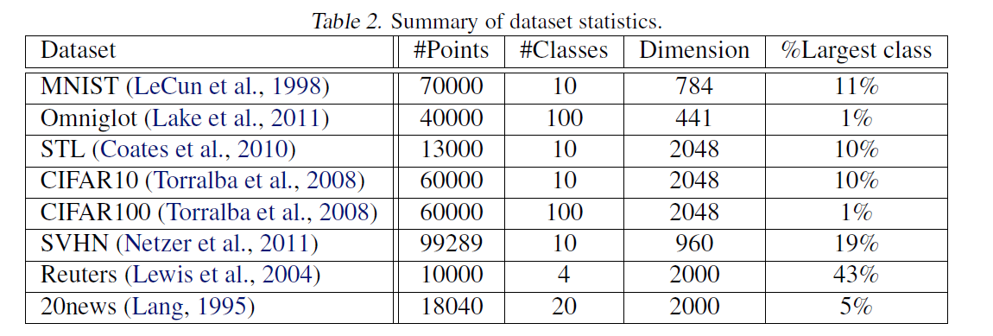
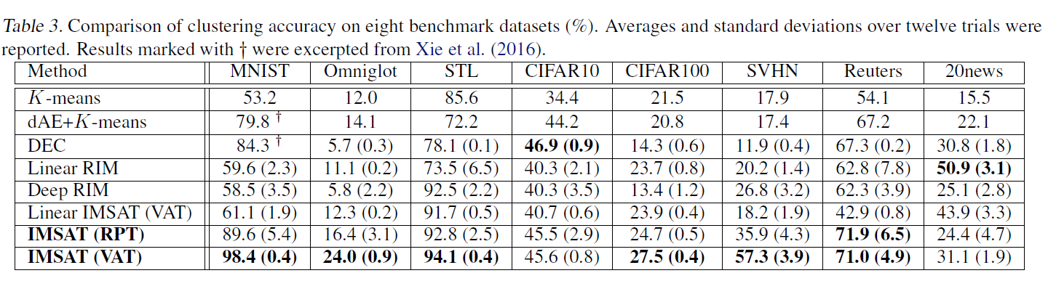
Results-Cluster

Slide 20
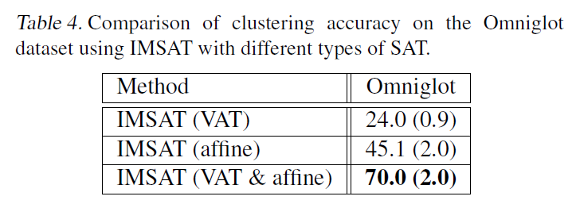
Results-Cluster
Further conducted experiments on the Omniglot dataset.
The method successfully captured the invariance in the hand-written character recognition in an unsupervised way.

Slide 21
Results-Hash learning
Dataset: MNIST and CIFAR10.
Metrics:
1) Mean average precision (mAP)
2) Precision at N = 500 samples
3) Hamming look-up result where the hamming radius is
set as r = 2
Randomly sampled 1000 samples, 100 per class, as the query data and used the remaining data as the gallery set.

Slide 22
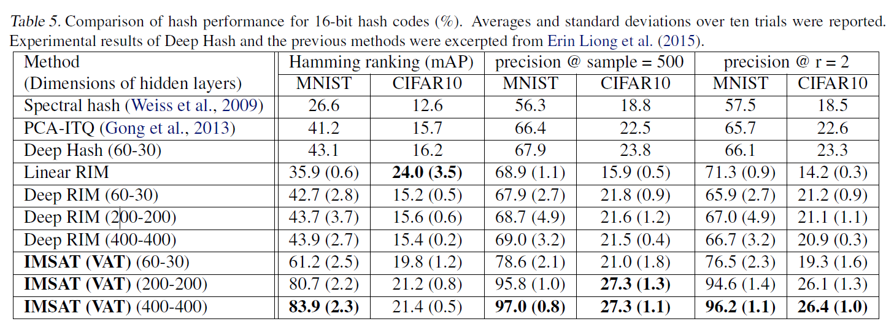
Results-Hash learning
The results for 32-bit hash codes showed a similar tendency as that of 16-bit hash codes.

Slide 23
Thanks

